Slide 1
Introduction to Data Science
John P Dickerson
Lecture #4 – 9/5/2019
CMSC320
Tuesdays & Thursdays
5:00pm – 6:15pm

Slide 2
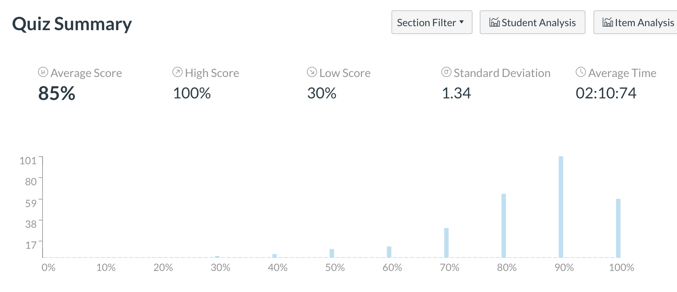
Quiz #1 Recap
Remember, quizzes are pass/fail
60% and higher → 100%
Please don’t email to bump an “80%” to a “90%” – because it doesn’t impact your grade at all

Slide 3
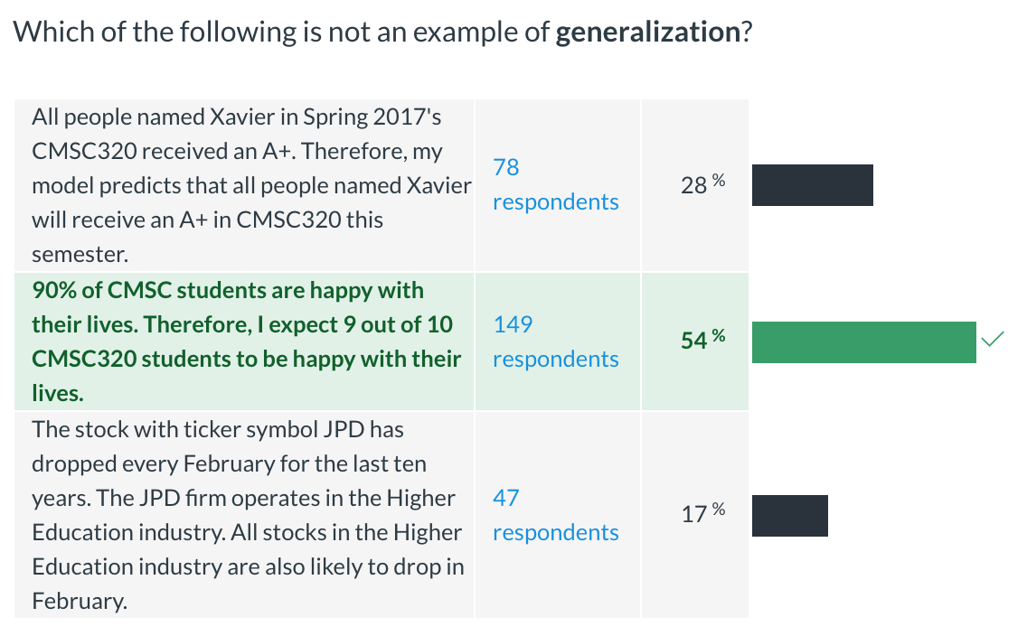
Quiz #1: Generalization

Slide 4
Announcements
Register on Piazza: piazza.com/umd/fall2019/cmsc320
298 have registered already?!
Probably a few haven’t registered yet?!
We will release the first mini-project soon.
Please make sure Jupyter installed correctly!
(See any of us if it didn’t.)

Slide 5
Next Few classes
NumPy: Python Library for Manipulating nD Arrays
Multidimensional Arrays, and a variety of operations including Linear Algebra
Pandas: Python Library for Manipulating Tabular Data
Series, Tables (also called DataFrames)
Many operations to manipulate and combine tables/series
Relational Databases
Tables/Relations, and SQL (similar to Pandas operations)
4. Apache Spark
Sets of objects or key-value pairs
MapReduce and SQL-like operations

Slide 6
Next Few classes
NumPy: Python Library for Manipulating nD Arrays
Multidimensional Arrays, and a variety of operations including Linear Algebra
Pandas: Python Library for Manipulating Tabular Data
Series, Tables (also called DataFrames)
Many operations to manipulate and combine tables/series
Relational Databases
Tables/Relations, and SQL (similar to Pandas operations)
4. Apache Spark
Sets of objects or key-value pairs
MapReduce and SQL-like operations

Slide 7
Numeric & scientific applications
Number of third-party packages available for numerical and scientific computing
These include:
NumPy/SciPy – numerical and scientific function libraries.
numba – Python compiler that support JIT compilation.
ALGLIB – numerical analysis library.
pandas – high-performance data structures and data analysis tools.
pyGSL – Python interface for GNU Scientific Library.
ScientificPython – collection of scientific computing modules.
Many, many thanks to: FSU CIS4930

Slide 8
NumPy and friends
By far, the most commonly used packages are those in the NumPy stack. These packages include:
NumPy: similar functionality as Matlab
SciPy: integrates many other packages like NumPy
Matplotlib & Seaborn – plotting libraries
iPython via Jupyter – interactive computing
Pandas – data analysis library
SymPy – symbolic computation library
[FSU]

Slide 9
The Numpy Stack
Mid- & Late-semester
Later
Today/next class
Image from Continuum Analytics
Notes:
NumPy = low-level LinAlg storage and manipulation
SciPy = scientific computing & stats algorithms built on top of NumPy
Pandas = friendlier version of NumPy backed by raw NumPy

Slide 10
numpy
Among other things, NumPy contains:
A powerful n-dimensional array object.
Sophisticated (broadcasting/universal) functions.
Tools for integrating C/C++ and Fortran code.
Useful linear algebra, Fourier transform, and random number capabilities, etc.
Besides its obvious scientific uses, NumPy can also be used as an efficient multi-dimensional container of generic data.
[FSU]

Slide 11
numpy
ndarray object: an n-dimensional array of homogeneous data types, with many operations being performed in compiled code for performance
Several important differences between NumPy arrays and the standard Python sequences:
NumPy arrays have a fixed size. Modifying the size means creating a new array.
NumPy arrays must be of the same data type, but this can include Python objects – may not get performance benefits
More efficient mathematical operations than built-in sequence types.
[FSU]

Slide 12
Numpy datatypes
Wider variety of data types than are built-in to the Python language by default.
Defined by the numpy.dtype class and include:
intc (same as a C integer) and intp (used for indexing)
int8, int16, int32, int64
uint8, uint16, uint32, uint64
float16, float32, float64
complex64, complex128
bool_, int_, float_, complex_ are shorthand for defaults.
These can be used as functions to cast literals or sequence types, as well as arguments to NumPy functions that accept the dtype keyword argument.
[FSU]

Slide 13
Numpy datatypes
>>> import numpy as np >>> x = np.float32(1.0) >>> x 1.0 >>> y = np.int_([1,2,4]) >>> y array([1, 2, 4]) >>> z = np.arange(3, dtype=np.uint8) >>> z array([0, 1, 2], dtype=uint8) >>> z.dtype dtype('uint8')
[FSU]

Slide 14
Numpy arrays
There are a couple of mechanisms for creating arrays in NumPy:
Conversion from other Python structures (e.g., lists, tuples)
Any sequence-like data can be mapped to a ndarray
Built-in NumPy array creation (e.g., arange, ones, zeros, etc.)
Create arrays with all zeros, all ones, increasing numbers from 0 to 1 etc.
Reading arrays from disk, either from standard or custom formats (e.g., reading in from a CSV file)
[FSU]

Slide 15
Numpy arrays
In general, any numerical data that is stored in an array-like container can be converted to an ndarray through use of the array() function. The most obvious examples are sequence types like lists and tuples.
>>> x = np.array([2,3,1,0])
>>> x = np.array([2, 3, 1, 0])
>>> x = np.array([[1,2.0],[0,0],(1+1j,3.)])
>>> x = np.array([[ 1.+0.j, 2.+0.j], [ 0.+0.j, 0.+0.j], [ 1.+1.j, 3.+0.j]])
[FSU]

Slide 16
Numpy arrays
Creating arrays from scratch in NumPy:
zeros(shape)– creates an array filled with 0 values with the specified shape. The default dtype is float64.
ones(shape) – creates an array filled with 1 values.
arange() – like Python’s built-in range
>>> np.zeros((2, 3)) array([[ 0., 0., 0.], [ 0., 0., 0.]])
>>> np.arange(10) array([0, 1, 2, 3, 4, 5, 6, 7, 8, 9]) >>> np.arange(2, 10, dtype=np.float) array([ 2., 3., 4., 5., 6., 7., 8., 9.]) >>> np.arange(2, 3, 0.2) array([ 2. , 2.2, 2.4, 2.6, 2.8])
[FSU]

Slide 17
Numpy arrays
linspace()– creates arrays with a specified number of elements, and spaced equally between the specified beginning and end values.
random.random(shape) – creates arrays with random floats over the interval [0,1).
>>> np.linspace(1., 4., 6) array([ 1. , 1.6, 2.2, 2.8, 3.4, 4. ])
>>> np.random.random((2,3)) array([[ 0.75688597, 0.41759916, 0.35007419], [ 0.77164187, 0.05869089, 0.98792864]])
[FSU]

Slide 18
Numpy arrays
>>> import numpy as np >>> a = np.arange(3) >>> print(a) [0 1 2] >>> a array([0, 1, 2]) >>> b = np.arange(9).reshape(3,3) >>> print(b) [[0 1 2] [3 4 5] [6 7 8]] >>> c = np.arange(8).reshape(2,2,2) >>> print(c) [[[0 1] [2 3]] [[4 5] [6 7]]]
Printing an array can be done with the print
statement (Python 2)
function (Python 3)
[FSU]

Slide 19
indexing
Single-dimension indexing is accomplished as usual.
Multi-dimensional arrays support multi-dimensional indexing.
>>> x = np.arange(10) >>> x[2] 2 >>> x[-2] 8
>>> x.shape = (2,5) # now x is 2-dimensional >>> x[1,3] 8 >>> x[1,-1] 9

Slide 20
indexing
Using fewer dimensions to index will result in a subarray:
This means that x[i, j] == x[i][j] but the second method is less efficient.
>>> x = np.arange(10) >>> x.shape = (2,5) >>> x[0] array([0, 1, 2, 3, 4])

Slide 21
indexing
Slicing is possible just as it is for typical Python sequences:
>>> x = np.arange(10) >>> x[2:5]
array([2, 3, 4])
>>> x[:-7]
array([0, 1, 2])
>>> x[1:7:2]
array([1, 3, 5])
>>> y = np.arange(35).reshape(5,7)
>>> y[1:5:2,::3]
array([[ 7, 10, 13], [21, 24, 27]])

Slide 22
Array operations
Basic operations apply element-wise. The result is a new array with the resultant elements.
>>> a = np.arange(5) >>> b = np.arange(5)
>>> a+b
array([0, 2, 4, 6, 8])
>>> a-b
array([0, 0, 0, 0, 0])
>>> a**2
array([ 0, 1, 4, 9, 16])
>>> a>3
array([False, False, False, False, True], dtype=bool)
>>> 10*np.sin(a)
array([ 0., 8.41470985, 9.09297427, 1.41120008, -7.56802495]) >>> a*b array([ 0, 1, 4, 9, 16])

Slide 23
Array operations
>>> a = np.zeros(4).reshape(2,2) >>> a array([[ 0., 0.], [ 0., 0.]]) >>> a[0,0] = 1 >>> a[1,1] = 1 >>> b = np.arange(4).reshape(2,2) >>> b array([[0, 1], [2, 3]]) >>> a*b array([[ 0., 0.], [ 0., 3.]]) >>> np.dot(a,b) array([[ 0., 1.], [ 2., 3.]])
Since multiplication is done element-wise, you need to specifically perform a dot product to perform matrix multiplication.

Slide 24
Array operations
>>> a = np.random.random((2,3)) >>> a array([[ 0.68166391, 0.98943098, 0.69361582], [ 0.78888081, 0.62197125, 0.40517936]]) >>> a.sum() 4.1807421388722164 >>> a.min() 0.4051793610379143 >>> a.max(axis=0) array([ 0.78888081, 0.98943098, 0.69361582]) >>> a.min(axis=1) array([ 0.68166391, 0.40517936])
There are also some built-in methods of ndarray objects. Universal functions which may also be applied include exp, sqrt, add, sin, cos, etc.

Slide 25
Array operations
>>> a = np.floor(10*np.random.random((3,4))) >>> print(a) [[ 9. 8. 7. 9.] [ 7. 5. 9. 7.] [ 8. 2. 7. 5.]] >>> a.shape (3, 4) >>> a.ravel() array([ 9., 8., 7., 9., 7., 5., 9., 7., 8., 2., 7., 5.])
>>> a.shape = (6,2) >>> print(a) [[ 9. 8.] [ 7. 9.] [ 7. 5.] [ 9. 7.] [ 8. 2.] [ 7. 5.]] >>> a.transpose() array([[ 9., 7., 7., 9., 8., 7.], [ 8., 9., 5., 7., 2., 5.]])
An array shape can be manipulated by a number of methods.
resize(size) will modify an array in place.
reshape(size) will return a copy of the array with a new shape.

Slide 26
Linear algebra
One of the most common reasons for using the NumPy package is its linear algebra module.
It’s like Matlab, but free!
>>> from numpy import * >>> from numpy.linalg import * >>> a = array([[1.0, 2.0],
[3.0, 4.0]]) >>> print(a) [[ 1. 2.] [ 3. 4.]] >>> a.transpose() array([[ 1., 3.], [ 2., 4.]]) >>> inv(a) # inverse array([[-2. , 1. ], [ 1.5, -0.5]])

Slide 27
Linear algebra
>>> u = eye(2) # unit 2x2 matrix; "eye" represents "I"
>>> u
array([[ 1., 0.], [ 0., 1.]])
>>> j = array([[0.0, -1.0], [1.0, 0.0]]) >>> dot(j, j) # matrix product array([[-1., 0.], [ 0., -1.]]) >>> trace(u) # trace (sum of elements on diagonal) 2.0 >>> y = array([[5.], [7.]]) >>> solve(a, y) # solve linear matrix equation array([[-3.], [ 4.]]) >>> eig(j) # get eigenvalues/eigenvectors of matrix (array([ 0.+1.j, 0.-1.j]), array([[ 0.70710678+0.j, 0.70710678+0.j], [ 0.00000000-0.70710678j, 0.00000000+0.70710678j]]))
(We’ll talk about this stuff as needed in the March/April machine learning and statistics lectures.)

Slide 28
SciPy?
In its own words:
Basically, SciPy contains various tools and functions for solving common problems in scientific computing.
SciPy is a collection of mathematical algorithms and convenience functions built on the NumPy extension of Python. It adds significant power to the interactive Python session by providing the user with high-level commands and classes for manipulating and visualizing data.

Slide 29
SciPY
SciPy gives you access to a ton of specialized mathematical functionality.
Just know it exists. We won’t use it much in this class.
Some functionality:
Special mathematical functions (scipy.special) -- elliptic, bessel, etc.
Integration (scipy.integrate)
Optimization (scipy.optimize)
Interpolation (scipy.interpolate)
Fourier Transforms (scipy.fftpack)
Signal Processing (scipy.signal)
Linear Algebra (scipy.linalg)
Compressed Sparse Graph Routines (scipy.sparse.csgraph)
Spatial data structures and algorithms (scipy.spatial)
Statistics (scipy.stats)
Multidimensional image processing (scipy.ndimage)
Data IO (scipy.io) – overlaps with pandas, covers some other formats

Slide 30
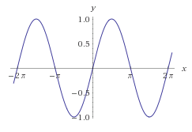
One SciPy Example
We can’t possibly tour all of the SciPy library and, even if we did, it might be a little boring.
Often, you’ll be able to find higher-level modules that will work around your need to directly call low-level SciPy functions
Say you want to compute an integral:
$$\int_{a}^{b}{\sin{x}dx}$$

Slide 31
Scipy.integrate
We have a function object – np.sin defines the sin function for us.
We can compute the definite integral from $x=0$ to $x=π$ using the quad function.
>>> res = scipy.integrate.quad(np.sin, 0, np.pi) >>> print(res) (2.0, 2.220446049250313e-14) # 2 with a very small error margin! >>> res = scipy.integrate.quad(np.sin, -np.inf, +np.inf) >>> print(res) (0.0, 0.0) # Integral does not converge

Slide 32
Scipy.integrate
Let’s say that we don’t have a function object, we only have some (x,y) samples that “define” our function.
We can estimate the integral using the trapezoidal rule.
>>> sample_x = np.linspace(0, np.pi, 1000) >>> sample_y = np.sin(sample_x) # Creating 1,000 samples >>> result = scipy.integrate.trapz(sample_y, sample_x) >>> print(result) 1.99999835177
>>> sample_x = np.linspace(0, np.pi, 1000000) >>> sample_y = np.sin(sample_x) # Creating 1,000,000 samples >>> result = scipy.integrate.trapz(sample_y, sample_x) >>> print(result) 2.0

Slide 33
Wrap up: First Part
Shift thinking from imperative coding to operations on datasets
Numpy: A low-level abstraction that gives us really fast multi-dimensional arrays
Next class:
Pandas: Higher-level tabular abstraction and operations to manipulate and combine tables
Reading Homework focuses on Pandas and SQL: Aim to release by tomorrow

Slide 34
Remainder of Today’s Lecture
Data collection
Data processing
Exploratory analysis
&
Data viz
Analysis, hypothesis testing, & ML
Insight & Policy Decision
Quick best practices
for managing this monstrosity.

Slide 35
Reproducibility
Extremely important aspect of data analysis
“Starting from the same raw data, can we reproduce your analysis and obtain the same results?”
Using libraries helps:
Since you don’t reimplement everything, reduce programmer error
Large user bases serve as “watchdog” for quality and correctness
Standard practices help:
Version control: git, git, git, …, git, svn, cvs, hg, Dropbox
Unit testing: unittest (Python), RUnit (R), testthat
Share and publish: github, gitlab
Many slides in this lecture adapted from Hector Corrado Bravo

Slide 36
Reproducibility
Open data: “Open data is the idea that some data should be freely available to everyone to use and republish as they wish, without restrictions from copyright, patents or other mechanisms of control”
Open Data movement website
http://www.opendatafoundation.org/

Slide 37
Practical Tips
Many tasks can be organized in modular manner:
Data acquisition:
Get data, put it in usable format (many ‘join’ operations), clean it up
Algorithm/tool development:
If new analysis tools are required
Computational analysis:
Use tools to analyze data
Communication of results:
Prepare summaries of experimental results, plots, publication, upload processed data to repositories
Usually a single language or tool does not handle all of these equally well – choose the best tool for the job!

Slide 38
Practical Tips
Modularity requires organization and careful thought
In Data Science, we wear two hats:
Algorithm/tool developer
Experimentalist: we don’t get trained to think this way enough!
It helps two consciously separate these two jobs

Slide 39
Think like an experimentalist
Plan your experiment
Gather your raw data
Gather your tools
Execute experiment
Analyze
Communicate

Slide 40
Think like an experimentalist
Let this guide your organization. One potential structure for organizing a project:
project/
| data/
| | processing_scripts
| | raw/
| | proc/
| tools/
| | src/
| | bin/
| exps
| | pipeline_scripts
| | results/
| | analysis_scripts
| | figures/

Slide 41
Think like an experimentalist
Keep a lab notebook!
Literate programming tools are making this easier for computational projects:
http://en.wikipedia.org/wiki/Literate_programming (Lec #2!)
https://ipython.org/
http://rmarkdown.rstudio.com/
http://jupyter.org/

Slide 42
Think like an experimentalist
Separate experiment from analysis from communication
Store results of computations, write separate scripts to analyze results and make plots/tables
Aim for reproducibility
There are serious consequences for not being careful
Publication retraction
Worse: http://videolectures.net/cancerbioinformatics2010_baggerly_irrh/
Lots of tools available to help, use them! Be proactive: learn about them on your own!

Slide 43
Bias, ethics, & responsibility

Slide 44
Data Science Lifecycle: An Alternate View

Slide 45
Examples of Bias
Genetic testing
Genetic tests for heart disorder and race-biased risk (NYTimes)
Race-bias in ancestry reports
Search results / feed optimization
Google
Facebook

Slide 46
Combating bias
Fairness through blindness:
Don’t let an algorithm look at protected attributes
Examples currently in use ??????????
Race
Gender
Sexuality
Disability
Religion
Problems with this approach ?????????

Slide 47
Combating Bias
Demographic parity:
A decision must be independent of the protected attribute
E.g., a loan application’s acceptance rate is independent of an applicant’s race (but can be depenedent on non-protected features like salary)
Formally: binary decision variable C, protected attribute A
P{ C = 1 | A = 0 } = P{ C = 1 | A = 1 }
Membership in a protected class should have no correlation with the final decision.
Problems ????????
Example from Moritz Hardt’s blog

Slide 48
Combating Bias
What if the decision isn’t the thing that matters?
“Consider, for example, a luxury hotel chain that renders a promotion to a subset of wealthy whites (who are likely to visit the hotel) and a subset of less affluent blacks (who are unlikely to visit the hotel). The situation is obviously quite icky, but demographic parity is completely fine with it so long as the same fraction of people in each group see the promotion.”
Demographic parity allows classifiers that select qualified candidates in the “majority” demographic and unqualified candidate in the “minority” demographic, within a protected attribute, so long as the expected percentages work out.
More: http://blog.mrtz.org/2016/09/06/approaching-fairness.html
Example from Moritz Hardt’s blog

Slide 49
FATML
This stuff is really tricky (and really important).
It’s also not solved, even remotely, yet!
CMSC498/499
New community: Fairness, Accountability, and Transparency in Machine Learning (aka FATML)
“… policymakers, regulators, and advocates have expressed fears about the potentially discriminatory impact of machine learning, with many calling for further technical research into the dangers of inadvertently encoding bias into automated decisions.”

Slide 50
F is for Fairness
In large data sets, there is always proportionally less data available about minorities.
Statistical patterns that hold for the majority may be invalid for a given minority group.
Fairness can be viewed as a measure of diversity in the combinatorial space of sensitive attributes, as opposed to the geometric space of features.
Thanks to: Faez Ahmed

Slide 51
A is for accountability
Accountability of a mechanism implies an obligation to report, explain, or justify algorithmic decision-making as well as mitigate any negative social impacts or potential harms.
Current accountability tools were developed to oversee human decision makers
They often fail when applied to algorithms and mechanisms instead
Example, no established methods exist to judge the intent of a piece of software. Because automated decision systems can return potentially incorrect, unjustified or unfair results, additional approaches are needed to make such systems accountable and governable.
Thanks to: Faez Ahmed

Slide 52
T is for transparency
Automated ML-based algorithms make many important decisions in life.
Decision-making process is opaque, hard to audit
A transparent mechanism should be:
understandable;
more meaningful;
more accessible; and
more measurable.
Thanks to: Faez Ahmed

Slide 53
Data collection
What data should (not) be collected
Who owns the data
Whose data can (not) be shared
What technology for collecting, storing, managing data
Whose data can (not) be traded
What data can (not) be merged
What to do with prejudicial data
Thanks to: Kaiser Fung

Slide 54
Data Modeling
Data is biased (known/unknown)
Invalid assumptions
Confirmation bias
Publication bias
WSDM 2017: https://arxiv.org/abs/1702.00502
Badly handling missing values
Thanks to: Kaiser Fung

Slide 55
Deployment
Spurious correlation / over-generalization
Using “black-box” methods that cannot be explained
Using heuristics that are not well understood
Releasing untested code
Extrapolating
Not measuring lifecycle performance (concept drift in ML)
We will go over ways to counter this in the ML/stats/hypothesis testing portion of the course
Thanks to: Kaiser Fung

Slide 56
Guiding principles
Start with clear user need and public benefit
Use data and tools which have minimum intrusion necessary
Create robust data science models
Be alert to public perceptions
Be as open and accountable as possible
Keep data secure
Thanks to: UK cabinet office

Slide 57
Some references
Presentation on ethics and data analysis, Kaiser Fung @ Columbia Univ. http://andrewgelman.com/wp-content/uploads/2016/04/fung_ethics_v3.pdf
O’Neil, Weapons of math destruction. https://www.amazon.com/Weapons-Math-Destruction-Increases-Inequality/dp/0553418815
UK Cabinet Office, Data Science Ethical Framework. https://www.gov.uk/government/publications/data-science-ethical-framework
Derman, Modelers’ Hippocratic Oath. http://www.iijournals.com/doi/pdfplus/10.3905/jod.2012.20.1.035
Nick D’s MIT Tech Review Article. https://www.technologyreview.com/s/602933/how-to-hold-algorithms-accountable/

Slide 58
Next Class: Pandas, Tidy Data & (Maybe) start on Relational Model of Data

